Slide 1
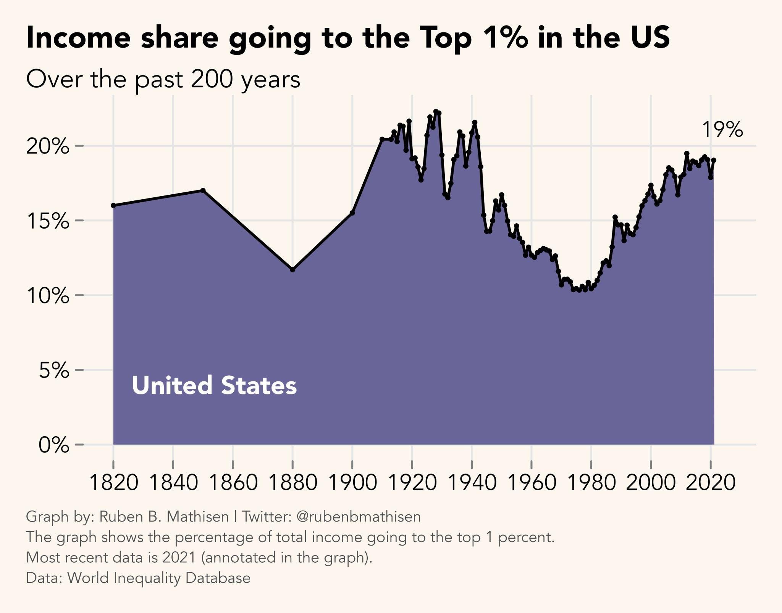
Go Back To Outline Page
Wealth Inequality
1940’s to 1970’s was the golden age of America’s middle class, but since then middle class incomes have not have not kept pace because laws and practices shifted away from wealth equality to the rich keeping it all for themselves. The U.S. was in this situation before in the early 1900’s and taxes and govt. benefits were realigned to correct this.
The largest groups to suffer from this have been blue collar workers (30% of America) and African Americans (14%). Add in service workers and all the kids of these disaffected groups who have grown up watching their parents suffer, and you have a large powerful voting bloc that is reasserting itself. The reindustrialization of America which is needing more workers is only adding more power to these groups.
Outcome: Taxes on rich, upper incomes, assets (real estate, investments)...will have to go up, most likely dramatically. Other forms of wealth transfer may emerge (student loan forgiveness, universal basic income, etc). Failure to rebalance wealth inequality will lead to societal violence and civil unrest/war.
SECTION 2: THE RECKONING Copyright © Eddie Soehnel

Slide 2
Go Back To Outline Page
Political Polarization
The root cause of this polarization is extreme wealth inequality.
Outcome:
We will see possibly new party or reconstituted party from existing ones (Democrat/Republican) come to power.
The party/candidate that can appeal to the disaffected classes (blue collar, African Americans, service workers and all their kids) will win. Losers are everyone else that will get steam rolled with new laws that disfavor them. New leaders will be pragmatic to solve our problems, not based on values or tradition.
States will be given more power to to decide key issues (gun rights, abortion) and people can move to the state that supports their view.
SECTION 2: THE RECKONING Copyright © Eddie Soehnel

Slide 3
Go Back To Outline Page
Civil War/National Breakup
What causes a civil war? It comes down to the following: If one side thinks the other side’s power leads to the inevitable demise if its identify, its status and way of life, this could trigger a civil war.
The risks to civil war for the U.S. are currently rooted in wealth inequality. Assuming we fix that through taxation/redistribution, and we reindustrialize like we are doing that reinvigorates the economy, then the risk for a civil war drops.
Assuming also we give states more power to to decide key issues (gun rights, abortion) and people can move to the state that supports their view, that can also diffuse the risk of a national breakup.
Outcome: we will create more equality through taxation/redistribution and give states more autonomy in deciding key issues for themselves.
SECTION 2: THE RECKONING Copyright © Eddie Soehnel

